Slide 1
Natural Resources Conservation Service in San Joaquin County
Ora Van Steyn
District Conservationist
10/24/17

Slide 2
Natural Resources Conservation Service (NRCS)
Mission: Helping People Help the Land
Provide technical and/or financial assistance to private land owners or managers to assist them to make sound natural resource management decisions.

Slide 3
NRCS Programs*
Conservation Stewardship Program (CSP)
Agricultural Conservation Easement Program (ACEP)
Conservation Technical Assistance (CTA)
Environmental Quality Incentive Program (EQIP)
*Most commonly used programs in San Joaquin County

Slide 4
Conservation Stewardship Program (CSP)
CSP participants will receive an annual land use payment for operation-level environmental benefits they produce. Under CSP, participants are paid for conservation performance: the higher the operational performance, the higher their payment.
Good program for growers who is already certified in Lodi Rule because they are most likely addressing all resource concerns. Also extensive record keeping is required.
All CSP contracts will have a minimum annual payment of $1,500.
Required to maintain the stewardship level of the resource concerns you are already meeting for the 5-year term of the CSP contract.
Annual payment has two parts – a payment of $350 for each resource concern you are already meeting and a per acre payment based on the land use ($7.50 per acre for cropland).
Program based on commodity crops so it is sometimes not friendly for specialty crops.

Slide 5
Agricultural Conservation Easement Program (ACEP)
NRCS provides financial assistance to eligible partners for purchasing Agricultural Land Easements that protect the agricultural use and conservation values of eligible land. In the case of working farms, the program helps farmers and ranchers keep their land in agriculture.
NRCS pays 100 percent of the easement value for the purchase of the easement.
Work with a partner land trust entity ( Ex: Central Valley Farmland Trust or SJCOG).
Easement is recorded with the deed and property owner maintains some rights.
Easement for estate planning purposes (If you want the property to stay in agriculture)

Slide 6
Conservation Technical Assistance (CTA)
Conservation technical assistance is the help NRCS and its partners provide to land users to address opportunities, concerns, and problems related to the use of natural resources.
CTA can assist with resource assessment, practice design, resource monitoring, or follow-up of installed practices.
CTA program does not include financial or cost-share assistance, but clients may develop conservation plans, which may serve as a springboard for those interested in participating in USDA financial assistance programs.

Slide 7
Conservation Planning
S - Soil
W - Water
A - Air
P - Plans
A - Animals
H – Human
+
E - Energy

Slide 8
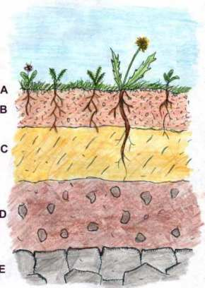
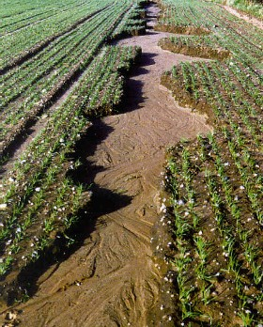
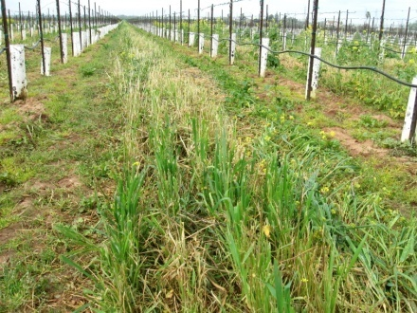
Soil
Loss of soil and
nutrients cause…
decreased fertility levels
wind and water erosion
decreasing crop yields
less water infiltration into the soil
Plant & Soil Science Department : University of Vermont
Have you…
had a soil test?
applied nutrients/fertilizers?
utilized cover crops?
NRCS cost shared conservation cover project

Slide 9
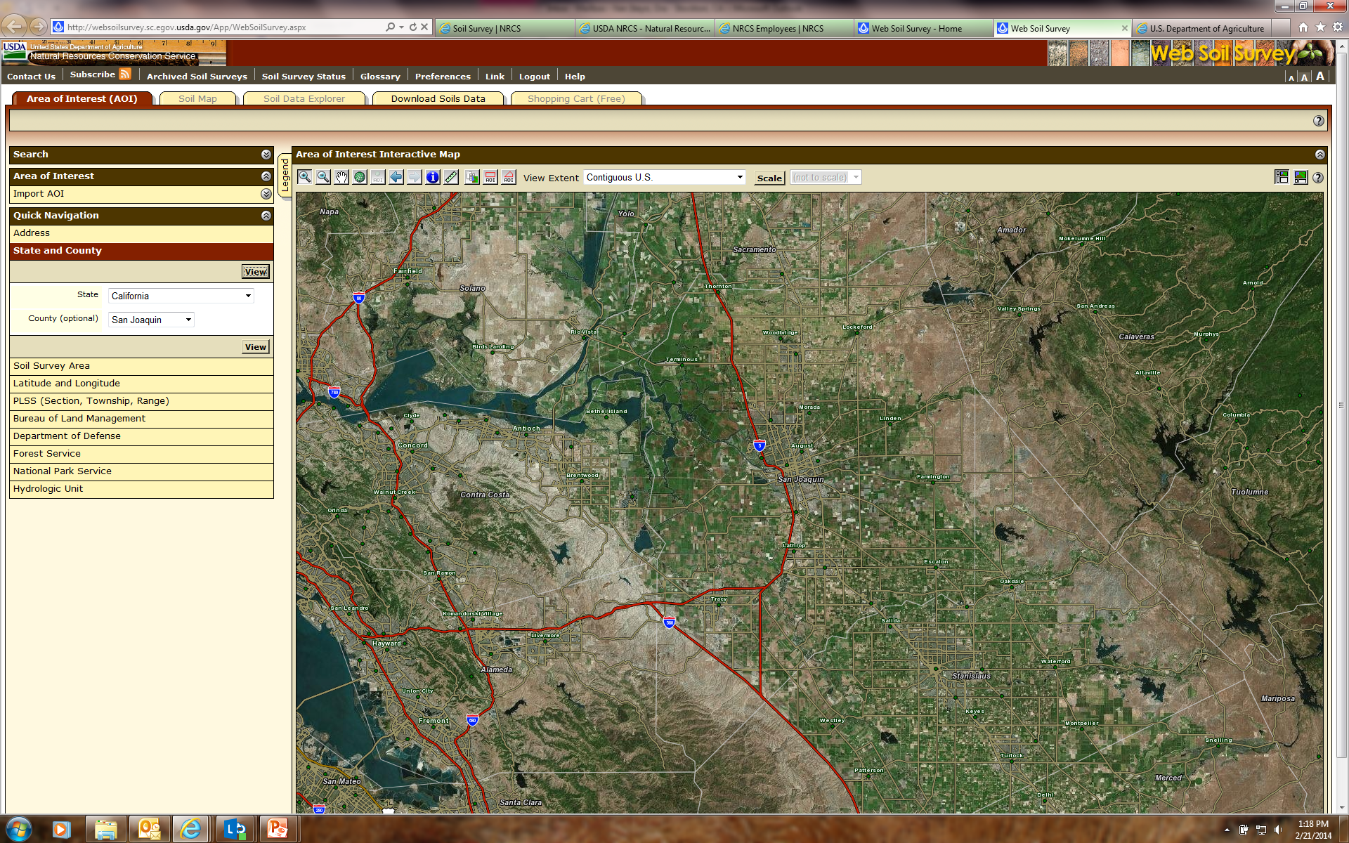
Web Soil Survey
http://websoilsurvey.sc.egov.usda.gov/App/WebSoilSurvey.aspx

Slide 10
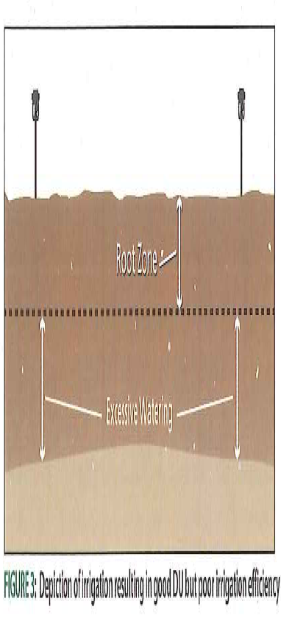
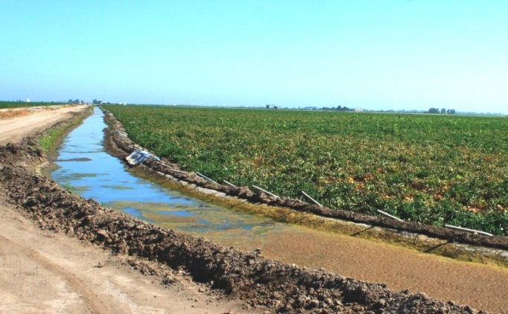
Water
Quantity
Infrastructure
Water rights
Quality
Surface
Ground Water
From Rain Bird Tech Spec L383
Excessive Watering = waste of water
AND = waste of your money
Have you…
had a pump efficiency test?
considered water savings irrigation systems?
incorporated flow meters and backflow valves?
had runoff issues?
ground water issues?

Slide 11
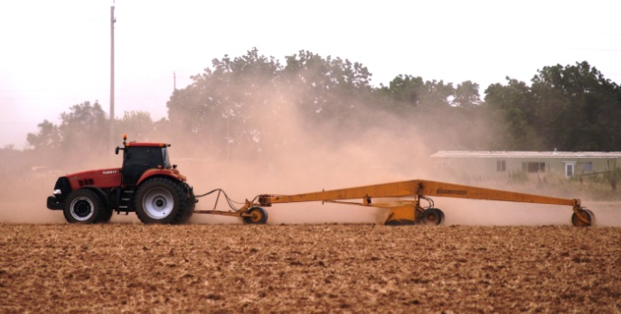
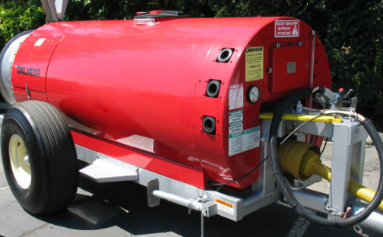
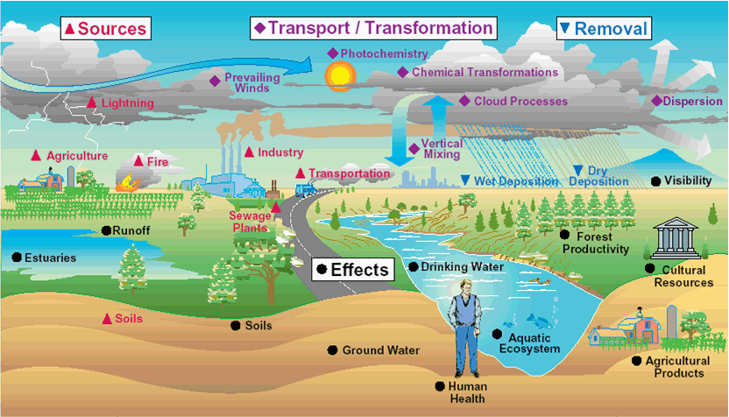
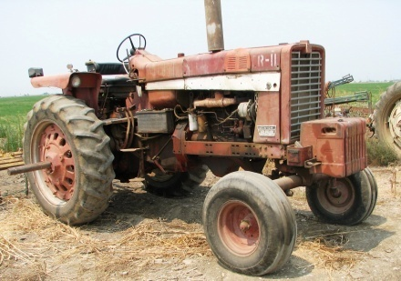
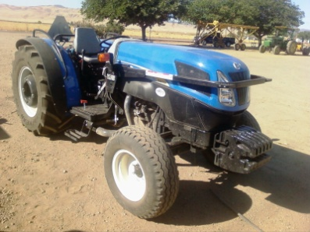
Air
Have you considered…
combining or eliminating tillage passes?
utilizing a electric irrigation pump?
replacing non-tiered older tractors?
using target application equipment?
dust control on roads?

Slide 12
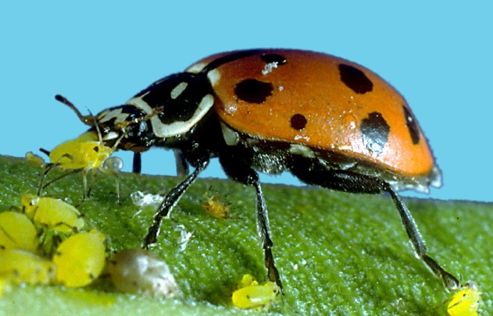
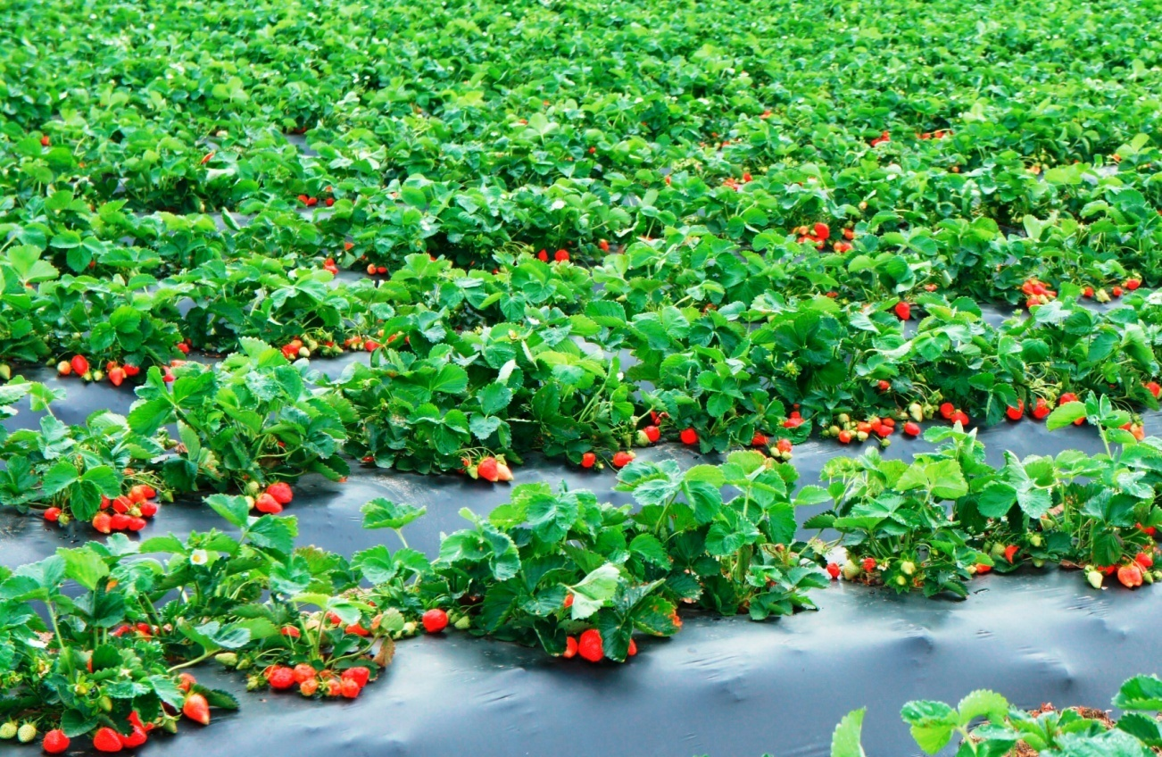
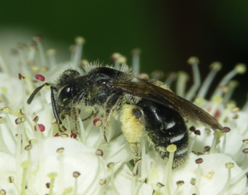
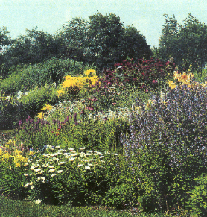
Plants
Are you maximizing your yield crop through use of nutrients/fertilizers?
Do you have problems with pest or weeds?

Slide 13
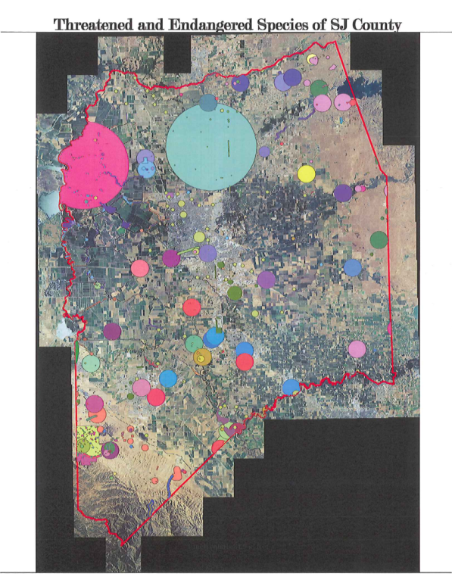
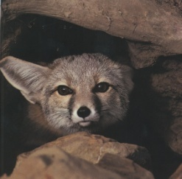
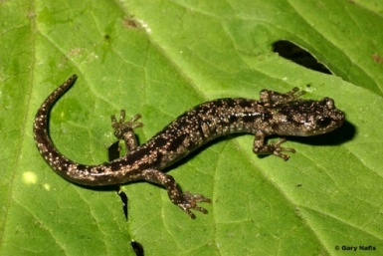
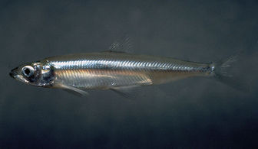
Animals
Can you utilize grazing animals in your eradication of invasive plants?
Threatened and Endangered Species in San Joaquin County
Alameda Whipsnake
Ca. red-legged frog
Ca. Tiger Salamander
Delta Smelt
San Joaquin Kit Fox
Swainson’s Hawk
Have you considered impact from farming practices on wildlife/habitat?
Are there opportunities to incorporate hedge rows or pollinator habitat?

Slide 14
Human + Energy
Economic Impacts (short/long term)
Labor
Energy Conservation
Future Generations
http://energytools.sc.egov.usda.gov/

Slide 15
Conservation Planning & Lodi Rules
Conservation Planning = Sustainability
Can be used as a first step in the Lodi Rules certification process.
Helps identify opportunities for improvement and gives suggestions of practices to implement.
Closely relates to Lodi Rules Standards
- Ecosystem Management
- Soil Management
- Water Management
- Pest Management

Slide 16
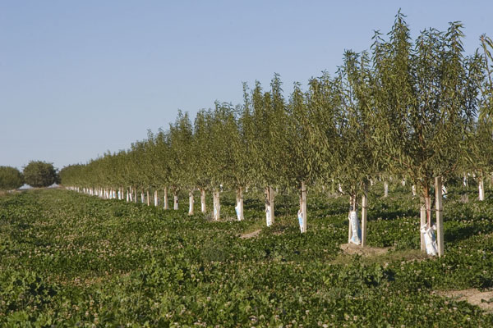
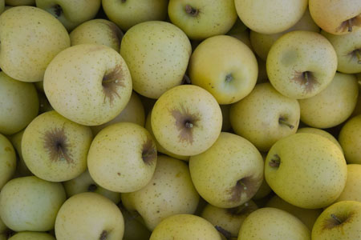
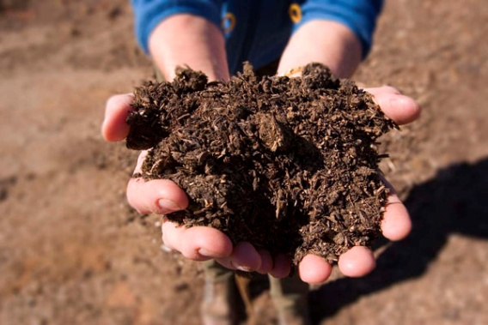
Environmental Quality Incentive Program
The Environmental Quality Incentives Program (EQIP) is a voluntary program that provides financial and technical assistance to agricultural producers to plan and implement conservation practices.

Slide 17
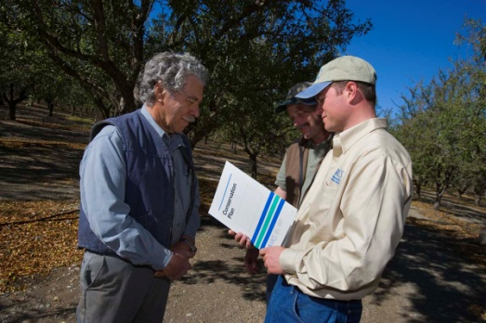
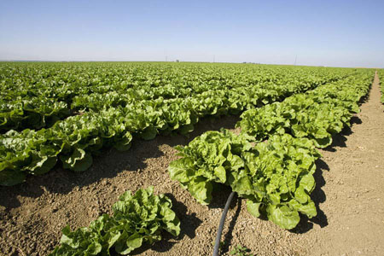
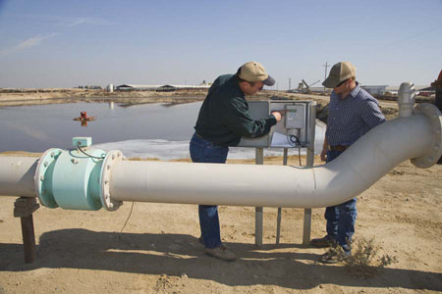
Common Conservation Practices for Vineyards
Cover Crop (planted acres)
Basic - $61.91/Ac
Multi Species - $72.73
Combustion System Improvement
25Hp-160Hp - $282.32/HP
Dust Control on Unpaved Roads
Petroleum based road oil – $.16/sqft
Micro-irrigation Systems
10 ac or less - $1295.98/Ac
>10 ac - $732. 70
Irrigation Water Management
Low to High Intensity - $23.29 – 48.27/Ac
Practice payments are based on the 2017 payment rate.

Slide 18
Application Screening & Ranking Process
Applications must be received, eligibility paperwork submitted and planning completed by the batching deadline.
Direct applications for different funding pool.
Ranking:
Examine and score how project addresses national, state, and local resource priorities.
Needs and Feasibility:
Site evaluations and producer interviews
Highest ranked applications in each funding pool are awarded contracts.

Slide 19
ESTABLISHING PARTICIPANT ELIGIBILITY: A SHARED RESPONSIBILITY

Slide 20
Participant Responsibilities
Submit a signed and dated NRCS-CPA-1200 form
Establish or update as needed farm records with Farm Service Agency (FSA) by providing to FSA or NRCS
Participant or participant’s representative’s responsibility to ensure that all 901 is accurate and all members sign and complete forms for adjusted gross income (AGI) and HEL/W (Highly Erodible Land/Wetland)

Slide 21
Working with FSA on Eligibility
Participant is responsible for their eligibility
Eligibility updates in FSA Systems
Participant makes request to FSA
FSA Farm Records
Participant must request farm record updates if needed
Participant must be AGI (Adjusted Gross Income) compliant for the year the contract is entered into
Use AD-2047-Customer Data Information Sheet for FSA’s MIDAS entry of customer data (SCIMS)

Slide 22
Eligibility Criteria
Documentation required to complete eligibility:
Certification of land control
AGI Certification: CCC-941 form
HELC/WC: AD-1026 form
Farming Records up to date
Direct Deposit: SF-1199 form and a voided check or bank signature
Signature Authority documentation if applicable:
CCC-901 form
Other documentation to establish signature authority
FSA-211 form or notarized general power of attorney
Permission to Install Structural and/or Vegetative Practices on leased land
Irrigation History: LTP-5 form - if irrigation practices are planned
DUNS Number is entered for Entity Participants

